Slide 1

IN HOUSE PROJECT
On
Data Visualization And Prediction Of CANCER
Using Linear Model Building
Done By
KOLLI.SOWMYA SRI
223411P
Under the guidance of
Ms. K. Divya

Slide 2
ABOUT DATA SET:
Variables | Datatype | Description
Age | int | Interger values representing patient Age
Gender | int | It representing the patient Gender
BMI | num | It representing the patient Body Mass Index
Smoking | num | It represents the smoking status of patient
GeneticRisk | num | It represents the patients genetic risk level of cancer
PhysicalActivity | num | It represents patient spend time on physical activity
AlcoholIntake | num | It represents the no.of alcohol units consumed
CancerHistory | num | It says that a patient has diagnosed by cancer in past or not
Diagnosis | num | it indicates cancer diagnosis status

Slide 3
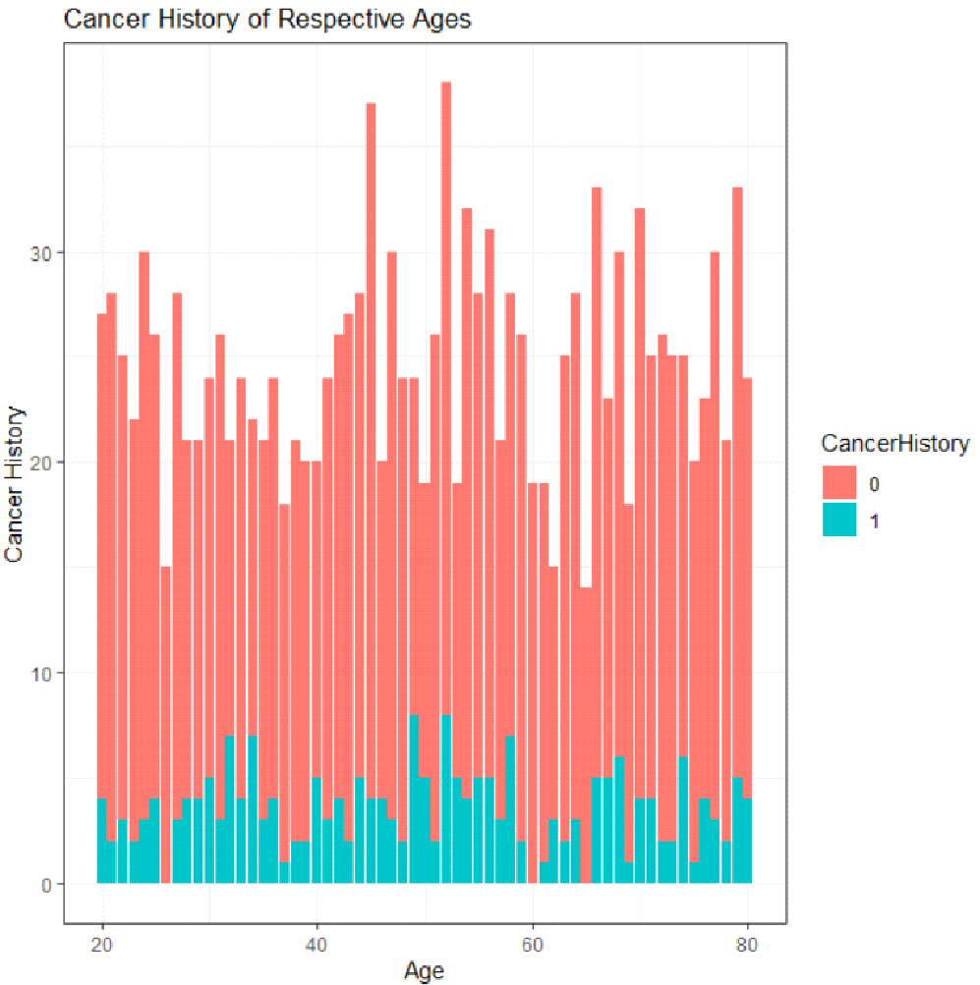
BAR GRAPH
The given bar graph shows that the cancer risk may be higher with age
he red bar represents individual without cancer history.
The green bar represents individual with cancer history.
Challenge 1
Challenge 2

Slide 4
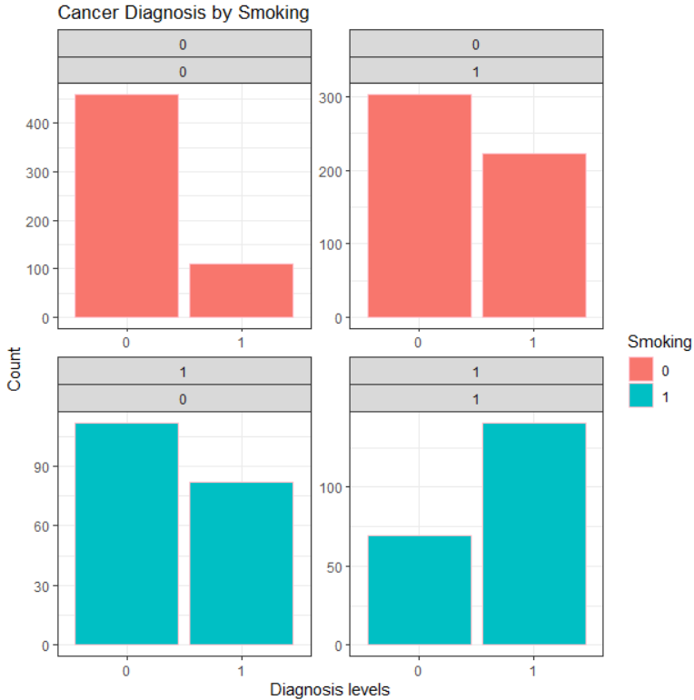
HISTOGRAM
It is the histogram graph comparing the cancer diagnosised patients with smoking status.
The graph represents the count of patients with and without a cancer diagnosis.
It highlights the impact of smoking by cancer risk
Challenge 1
Challenge 2

Slide 5
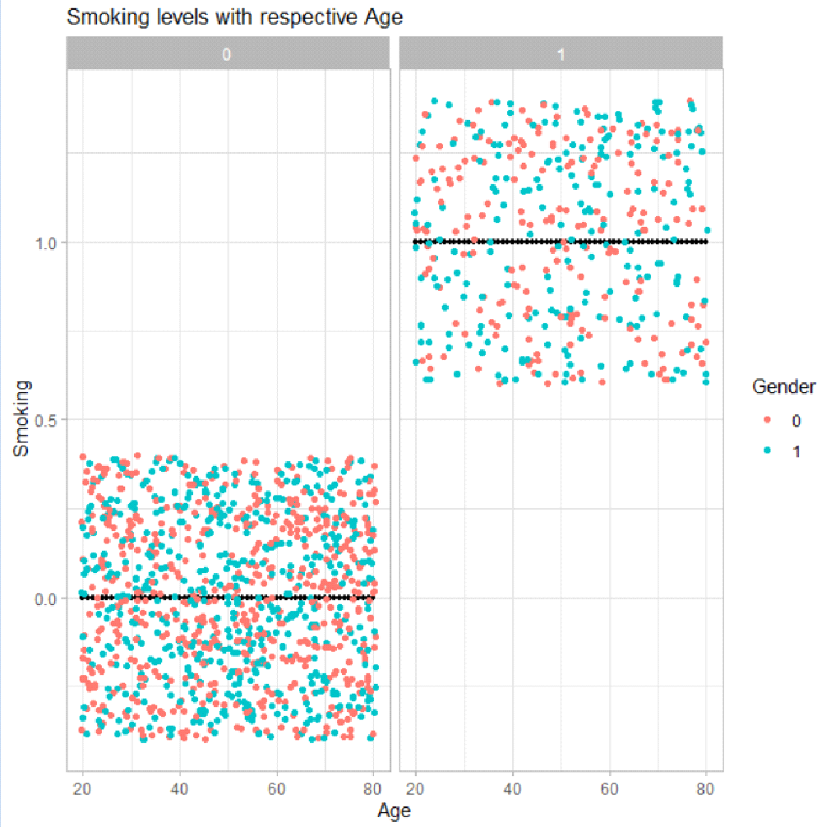
BOXPLOT
The given scattered boxplot shows that the smoking levels tends to increase with age.
The red dots represents male.
The green dots represents female.
Challenge 1
Challenge 2

Slide 6
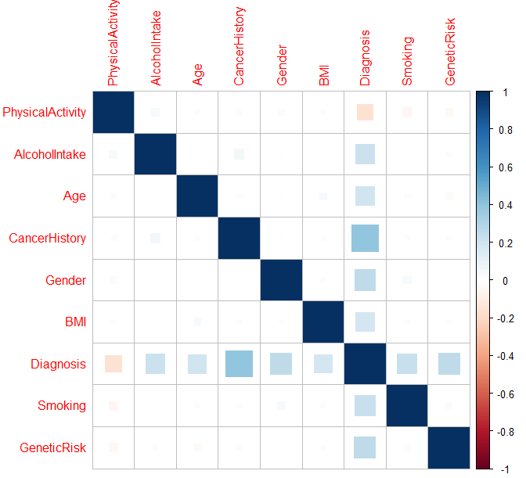
CORRELATION GRAPH
The given Correlation graph shows that ,
Light colour box represents the low correlation between variables.
Dark colour box represents the high correlation between the variables.
Challenge 1
Challenge 2

Slide 7
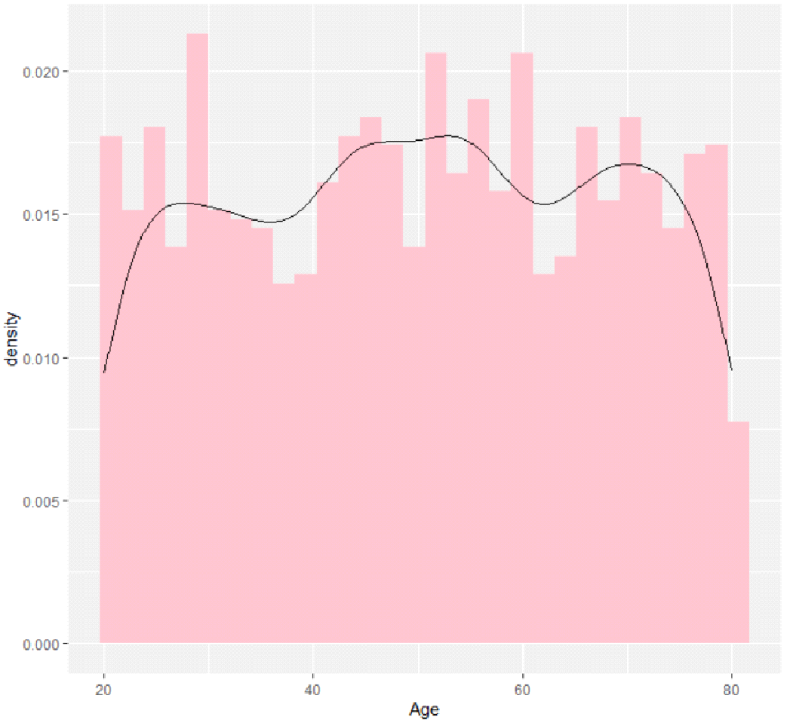
LINEAR REGRESSION
The given histogram with density shows that the nature of the target variables,it is mainly used to understand the nature of target variables.
Challenge 1
Challenge 2

Slide 8
MEAN ABSOLUTE ERROR
RESIDUAL SUM OF SQUARES
R-SQUARED VALUE
0.1030625
0.135217
8.191064
899.9022
0.9915
ROOT MEAN SQUARED ERROR
TOTAL SUM OF SQYARES

Slide 9
CONCLUSION
From the above analysis, it can be concluded that this model involves predicting an individual's likelihood of being diagnosed with cancer based on various attributes. These attributes include age, gender, BMI, alcohol intake, smoking habits, cancer history, physical activity, and other relevant factors.The model used to analyze the data has a strong predictive power (RSQ of 0.991560), indicating its effectiveness in explaining the spending patterns.
For individuals seeking to understand their cancer risk, it is crucial to consider these attributes with great care, similar to how one would approach any significant health-related decision. The analysis indicates that certain factors play a more prominent role in predicting cancer risk.

Slide 10


